Slide 1
Morphology and anatomy of leaves

Slide 2
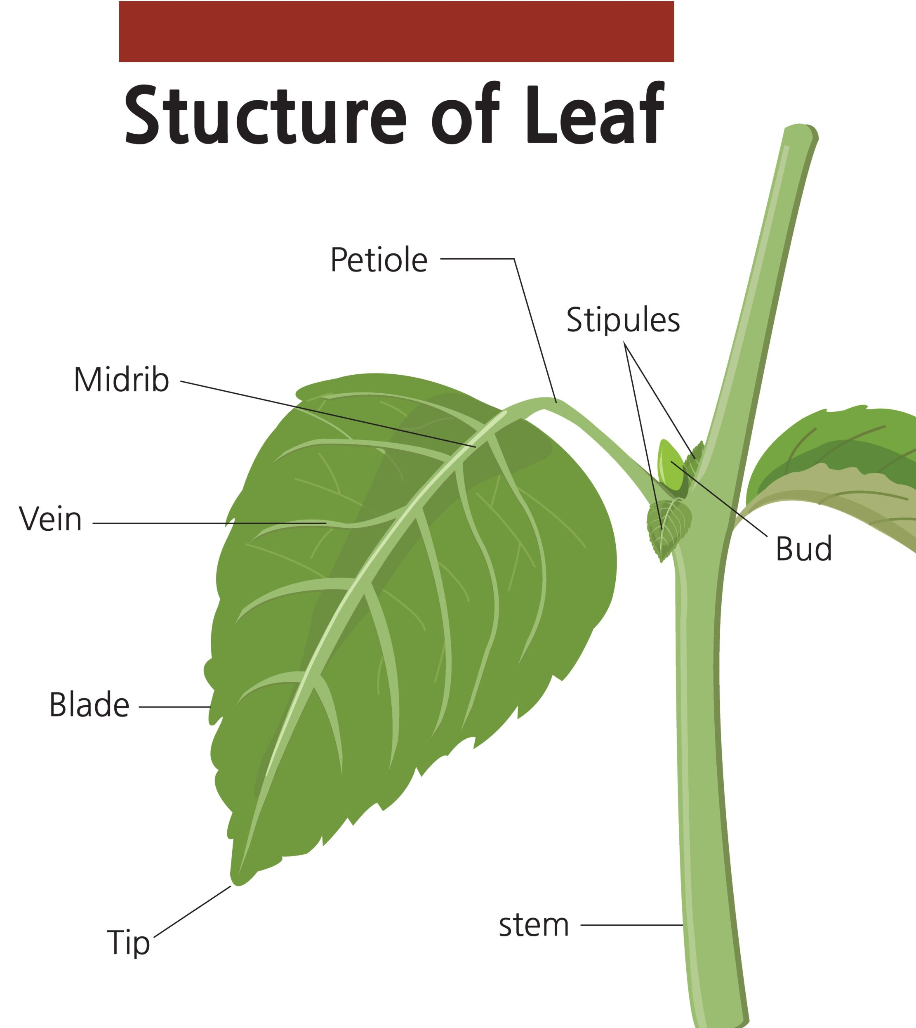
Morphology of leave
A leaf is a green above-ground plant organ.
Generally, leaf base, petiole, and lamina, together form the main parts of a leaf.
Generally, leaf base, petiole, and lamina, together form the main parts of a leaf.
Leaf Base: This is the part where a leaf attaches to the stem. Leaf base has two small leaf-like structure called stipules. In plants like paddy, wheat, and other monocotyledons, this leaf base is wide and masks the stem.
Petiole: Petiole is the long, thin, stalk that links the leaf blade to the stem.
Lamina: Also known as leaf blade. It is the green, flat surface of the leaves. It consists of a small branched vein and veinlets. The vein that runs along the middle of the lamina is called midrib. Midrib divides the surface of the lamina into two. These veins and veinlets give rigidity to the leaf blade and help in the transportation of water and other substances.

Slide 3
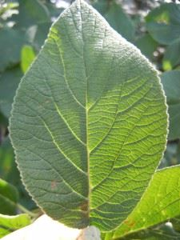
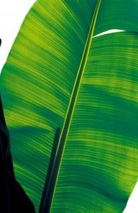
Venation
Venation is defined as the arrangement of veins and the veinlets in the leaves. Different plants show different types of venation. Generally, there are two types of venation:
Reticulate venation: In a reticulate venation, the veinlets are randomly arranged and form a complex network of veinlets. Ex: Dicotyledonous plants like a rose plant.
Parallel venation: In a parallel venation, the veinlets run parallel to each other. Ex: In monocotyledons like paddy.
Reticulate venation
Parallel venation:

Slide 4
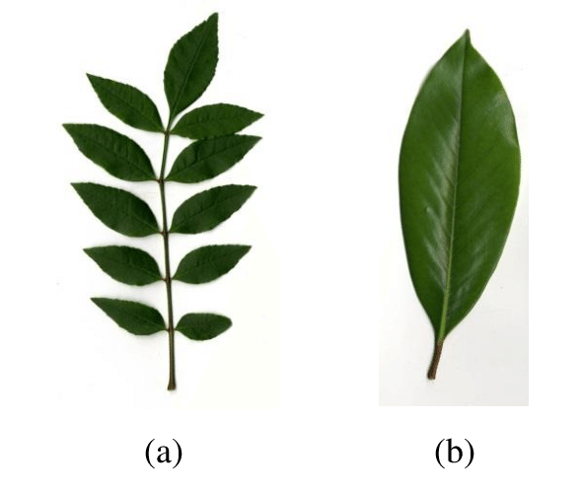
Types of Leaves
There are two broad categories of leaves – simple and compound, which are further classified into different groups based on their shape, size, their arrangements on the stem, leaves of flowering and non-flowering plants, and various other physical attributes.
The two different types of leaves found in a plant are:
Simple Leaf
When a single lamina is connected to the main stem by a petiole, the leaf is said to be simple.
Compound Leaf
A compound leaf is a leaf made up of two or more leaflets. In a compound leaf, the midrib of the leaf is branched into different leaflets and is connected by a single petiole. For eg., Pea, palm leaves.

Slide 5
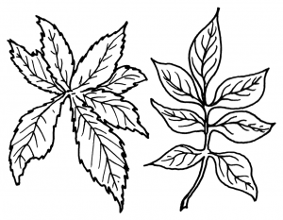
Pinnately Compound Leaves: Here, the midrib of the leaf becomes the branch on which different leaflets arise. A common axis connects all of the brochures. These are further divided into:
Unipinnate: The leaflets arise on each side of the axis of the leaf. E.g., cassia
Bipinnate: The leaflets arise from a second axis, which originates from the central axis. E.g., Acacia
Tripinnate: The leaflets arise from the tertiary axis that arises from the secondary axis. E.g., Moringa
Decompound: If the leaflets have more than three pinnate, it is classified as decompound. E.g., Coriander
Paripinnate: The terminal leaflet is absent. E.g., Cassia.
Imparipinnate: If the terminal leaflet is odd, it is termed imparipinnate. E.g., Pea plants.
Palmately Compound: In this type, the leaflets arise from a single point of origin and hence form like a palm of the hand. E.g., cotton leaves. It is further classified into:
Unifoliate: Here, only one leaflet originates from the same point. E.g., citrus fruits.
Bifoliate: Here, two leaflets arise from the same point. Eg Balanites.
Trifoliate: There are three leaflets that originate from the same point. E.g., Oxalis.
Quadrifoliate: Four leaflets arise from the same point. Eg Marsilea.
Multifoliate: Many leaflets arise from the same point. Eg Bombax.
Pinnately / Palmately

Slide 6
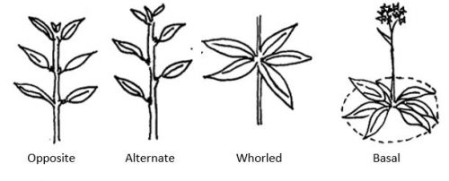
Phyllotaxy
The patterns of arrangement of leaves on the stem are called Phyllotaxy. Plants show three types of phyllotaxy- alternate, opposite and whorled types of phyllotaxy.
When only a single leaf develops at each node alternatively, it is an alternate type of phyllotaxy.E.g. China rose.
When a pair of leaves develops at each node opposite to each other, it is called opposite phyllotaxy.E.g. Guava plants.
When more than two leaves develop at the nodes to form a whorl of leaves, it is called whorled phyllotaxy. E.g. Alstonia

Slide 7
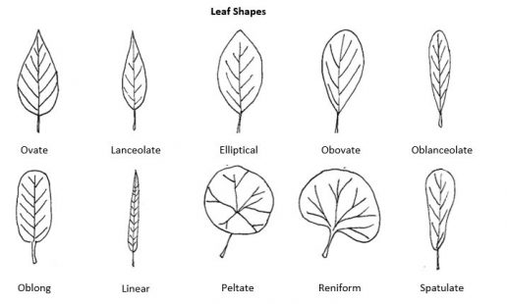
Leaf morphology chart with narrow to broad examples.

Slide 8
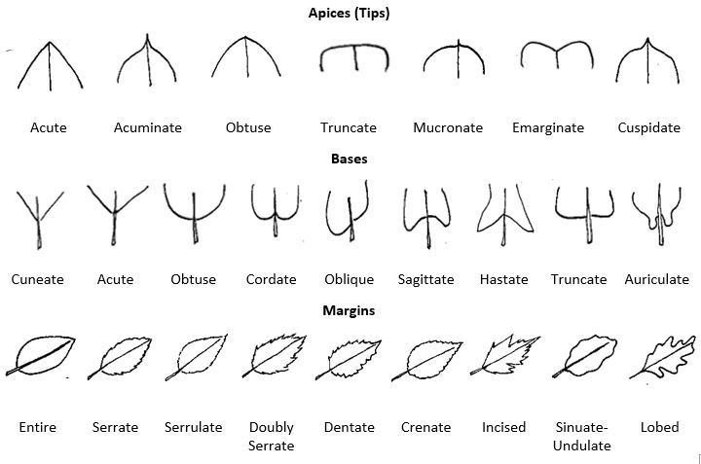
Additional morphological features for description include leaf shape, tip and base features, and margins (edges).
Leaf morphology chart of tips, bases, and margins.

Slide 9
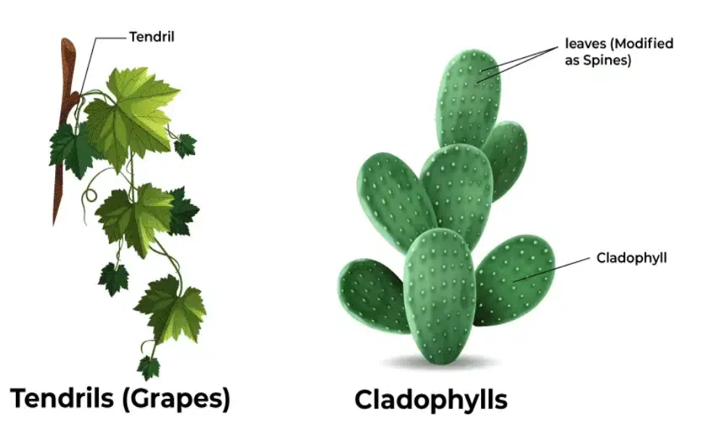
Modification of Leaves
Tendrils: When Leaves are modified into wiry and structures then these are called as tendrils, these are help the climbers to climb.
Spines: When Leaves are converted into pointed structure and these structures protect the plant from herbivores.
Phyllode: When petiole is modified into extended green structures which carries out photosynthesis.
Storage leaves: Due to storage of water and food these Leaves are become fleshy.
Cotyledons: Cotyledons are shown by mature embryo which may be one or two.
Leaf bladders: Leaves of the some aquatic plants are modified into leaf bladders which trap the small insects.
Leaf pitcher: Leaf lamina is modified into a lid which is called as pitcher and this trap the insects and fulfill nitrogen requirement.

Slide 10
Functions of Leaves
Photosynthesis: Leaves have green color pigment i.e. chlorophyll which entrap sunlight and forms glucose from carbon-dioxide and water. This process is called as photosynthesis.
Transpiration: Leaves remove the excess water through stomata in the form of water vapor and allows the water conduction from the roots.
Exchange of gases: Through stomata exchange of gases takes place.
Storage of food: In some plants, modified Leaves are present which participate in storage of food.

Slide 11
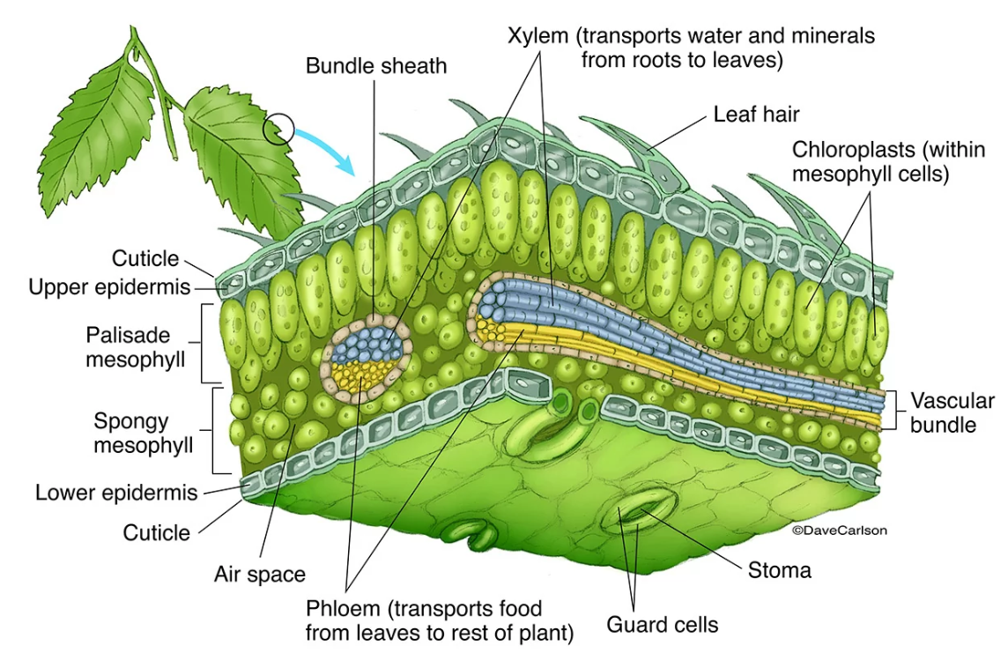
Anatomical structure of leaves
https://www.carlsonstockart.com/gallery/botany/

Slide 12
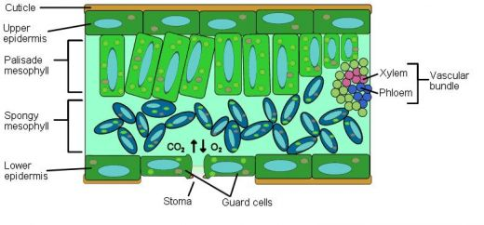
mesophyll - the chlorophyll-containing leaf tissue located between the upper and lower epidermis. These cells convert sunlight into usable chemical energy for the plant.
spongy mesophyll - the layer below the palisade mesophyll; it has irregularly-shaped cells with many air spaces between the cells.
palisade mesophyll - a layer of elongated cells located under the upper epidermis. These cells contain most of the leaf's chlorophyl converting sunlight into usable chemical energy for the plant.
air space - intercellular gaps within the spongy mesophyll. These gaps are filled with gas that the plant uses (carbon dioxide - CO2 ) and gases that the plant is expelling (oxygen - O2, and water vapor).

Slide 13
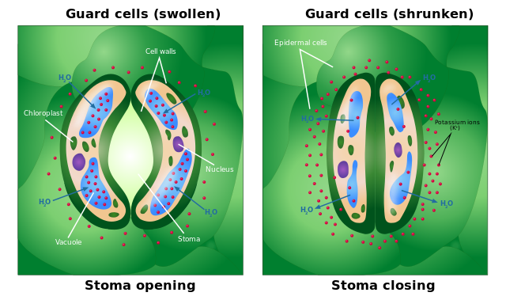
guard cell - one of a pair of sausage-shaped cells that surround a stoma (a pore in a leaf). Guard cells change shape (as light and humidity change), causing the stoma to open and close.
stoma - (plural stomata) a pore (or opening) in a plant's leaves where water vapor and other gases leave and enter the plant. Stomata are formed by two guard cells that regulate the opening and closing of the pore. Generally, many more stomata are on the bottom of a leaf than on the top.

Slide 14
chlorophyll - a molecule in leaves that can use light energy from sunlight to turn water and carbon dioxide gas into sugar and oxygen (this process is called photosynthesis). Chlorophyll is magnesium-based and is green.
photosynthesis - the process in which plants convert sunlight, water, and carbon dioxide into food energy (sugars and starches), oxygen and water. Chlorophyll or closely-related pigments (substances that color the plant) are essential to the photosynthetic process.

Slide 15
cuticle - the waxy, water-repelling layer on the outer surface of a leaf that helps keep it from dying out (and protect it from invading bacteria, insects, and fungi). The cuticle is secreted by the epidermis (including the guard cells) and is often thinner on the underside of leaves. The cuticle is generally thicker on plants that live in dry environments.
epidermis - the protective, outler layer of cells on the surface of a leaf. The guard cells (and stoma) are part of the epidermis. The surface of many leaves is coated with a waxy cuticle which is secreted by the epidermis.

Slide 16
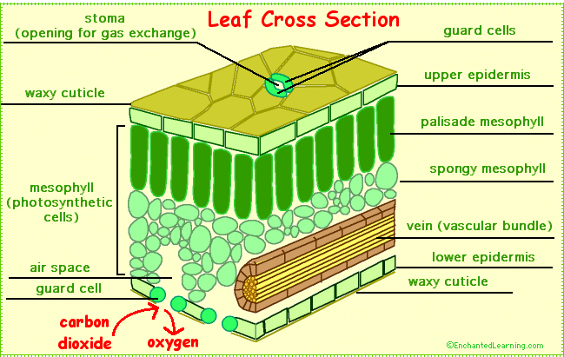

Slide 17
Key Points on Leaves
The photosynthetic pigment chlorophyll is present in Leaves, which are located at the stem’s nodes.
A leaf is composed of three primary parts: the petiole, the lamina, and the base of the leaf.
Simple Leaves and complex Leaves are the two different kinds of Leaves.
They assist in the process of removing extra water from the plant’s aerial portions and carry out photosynthesis.
Their ability to adapt to different settings is aided by their modification in the form of scales, tendrils, hooks, and spines.

